Slide 1
Gene Sequence Analysis
Lecture 2: Pairwise Alignment
Adapted from Dr. Morgan Langille’s Lecture
30/05/2024
Phuc-Loi Luu, PhD

Slide 2
Importance of Similarity
Ancestral protein/gene sequence
Similar (homologous) protein/gene
sequences
Similar sequences: probably have the same ancestor, share the same structure, and have a similar biological function

Slide 3
Importance of Similarity
Sequence DB
unknown function ?
Similarity Search
similar protein
with known function
extrapolate
function

Slide 4
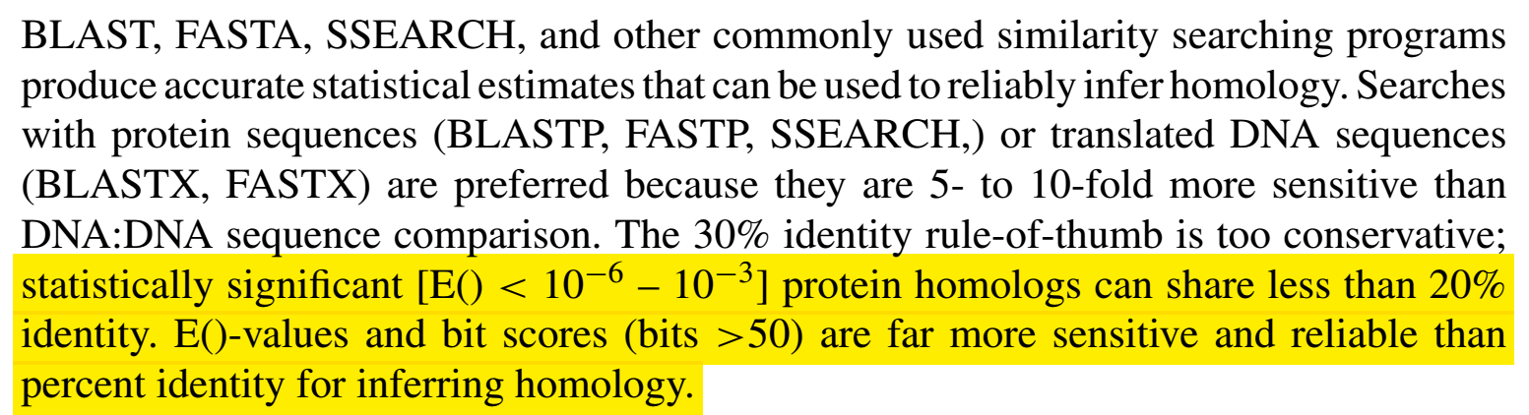
Importance of Similarity
Rule-of-thumb:
If your sequences are more than 100 amino acids long (or 100 nucleotides long) you can considered them as homologues if 25% of the aa are identical (70% of nucleotide for DNA). Below this value you enter the twilight zone.
Twilight zone = protein sequence similarity between ~0-20% identity: is not statistically significant, i.e. could have arisen by chance.
Beware:
E-value (Expectation value)
length of the segments similar between the two sequences
The number of insertions/deletions

Slide 5
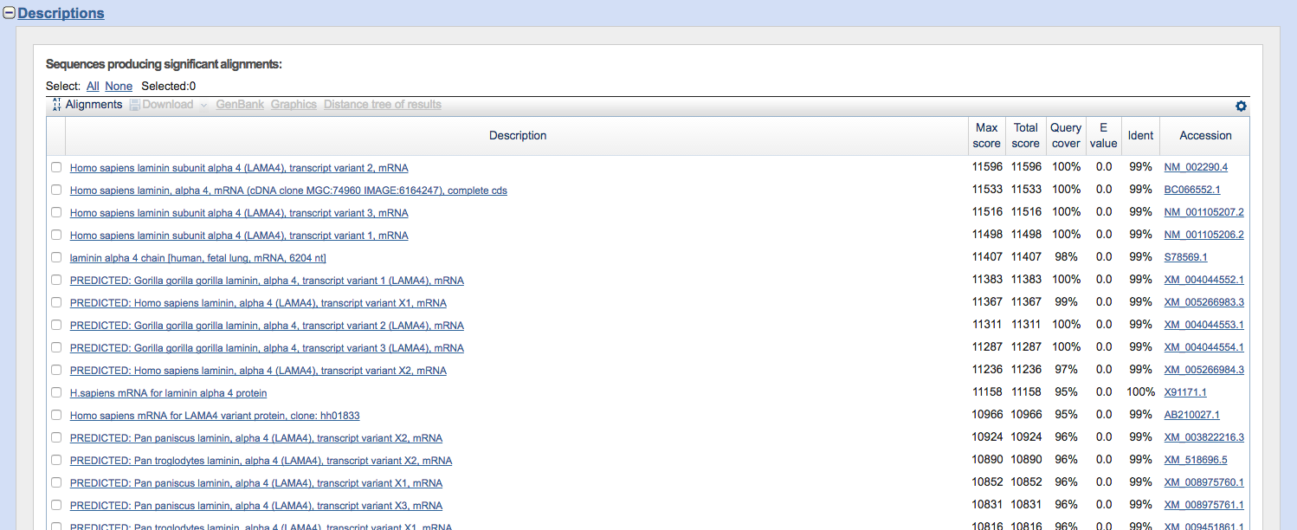
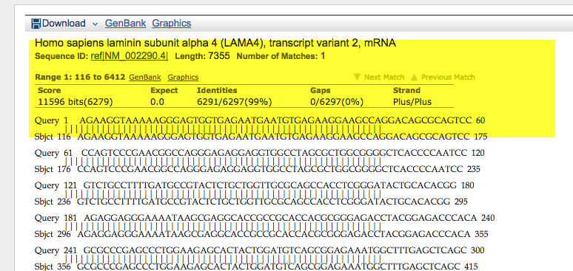

Slide 6
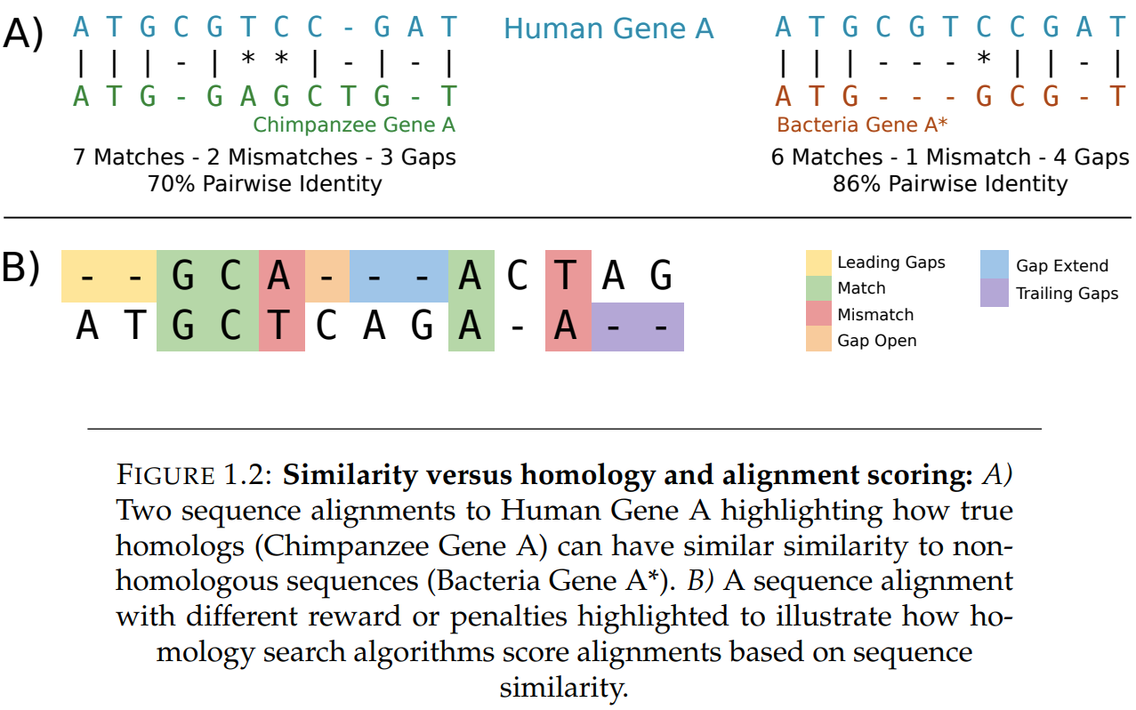
https://ourarchive.otago.ac.nz/bitstream/handle/10523/9302/McGimpseyStephanie2019MSc.pdf

Slide 7
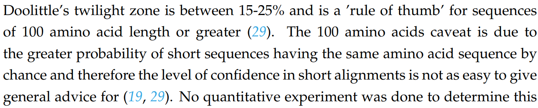
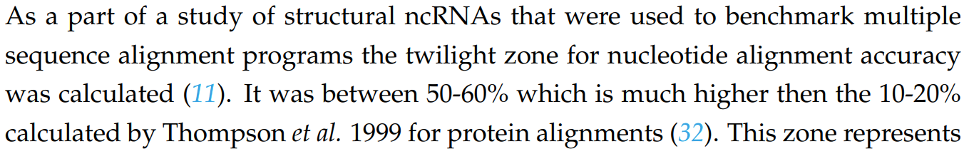
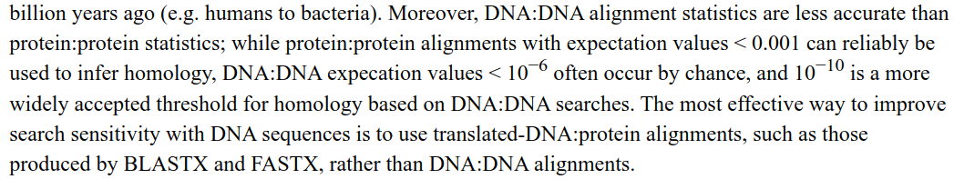
https://ourarchive.otago.ac.nz/bitstream/handle/10523/9302/McGimpseyStephanie2019MSc.pdf
https://www.ncbi.nlm.nih.gov/pmc/articles/PMC3820096/

Slide 8
Outline
PSSMs/PSI-BLAST
HMMs/HMMer RNA Alignments
Genome Alignments Assemblers Mappers
●
●
●
●

Slide 9
Different tools for homology searching
Searching for protein families
Aligning genomes
Looking for RNA genes
Combining overlapping sequences (assemblers)
Finding the position of a sequence in a genome
●
●
●
●
●

Slide 10
One tool does not do it all
●
Blast may give you an answer
●
BUT you could find the answer much quicker or with more precision by using the right tool!

Slide 11
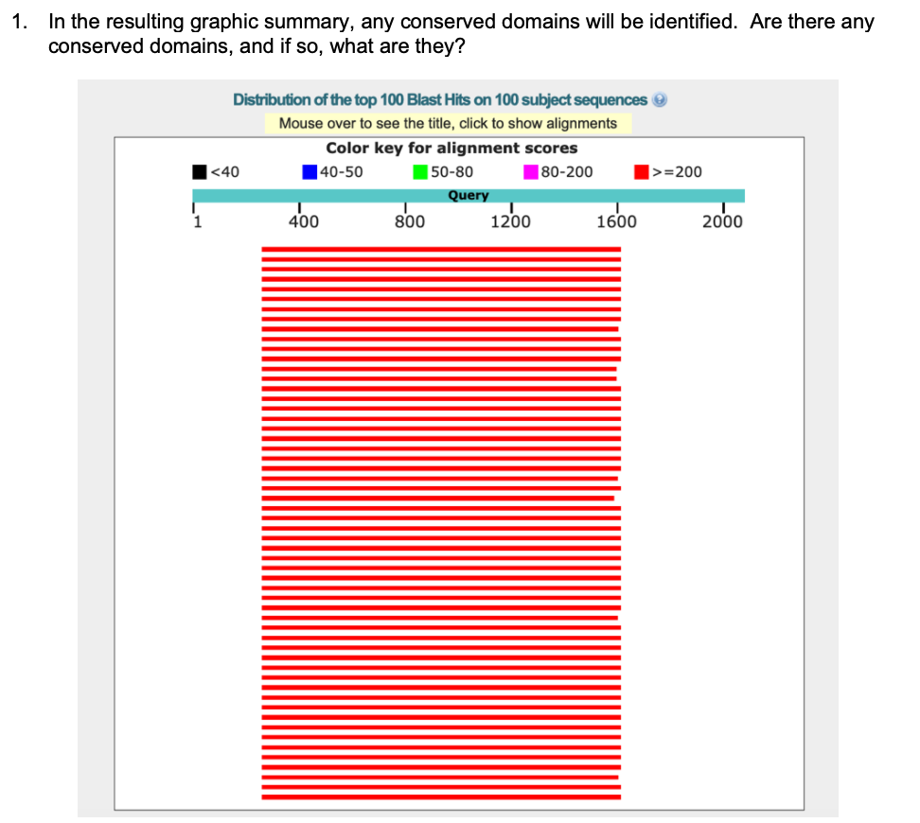
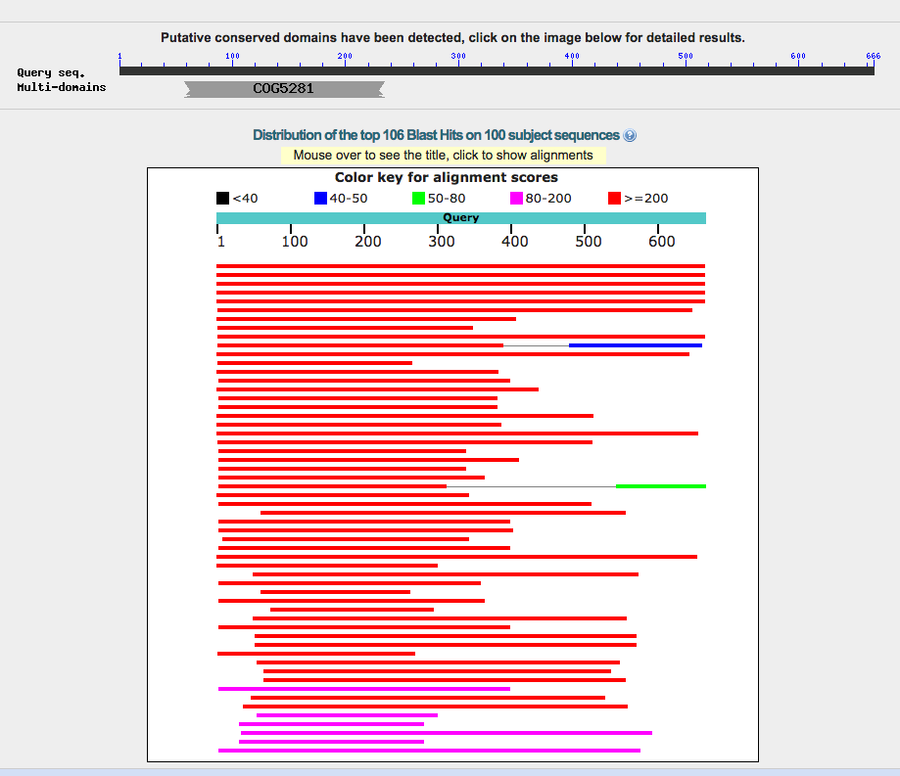
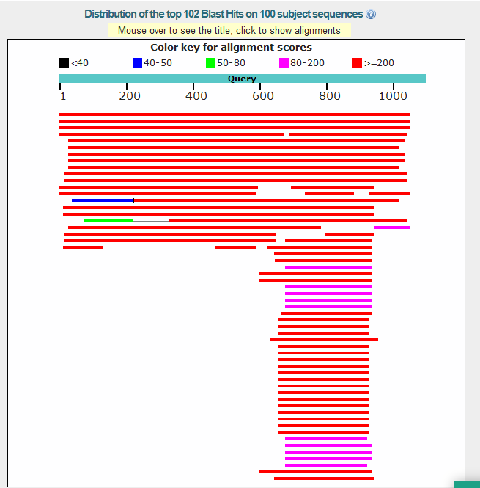
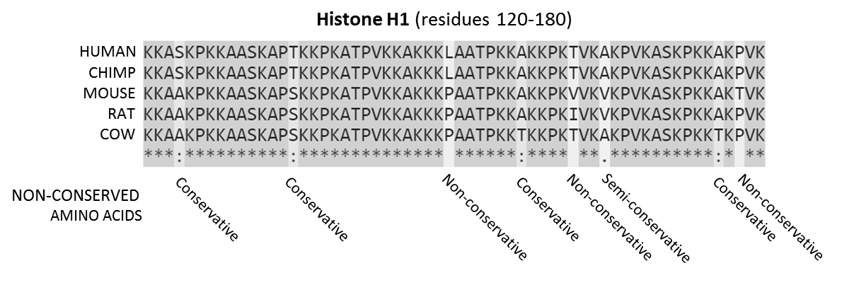
Typical BLAST output
https://en.wikipedia.org/wiki/Sequence_alignment

Slide 12
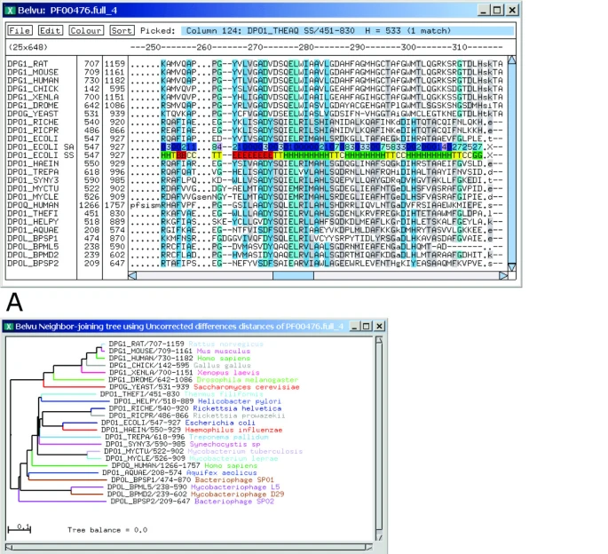
Distance related proteins
10.1186/1471-2105-6-108

Slide 13
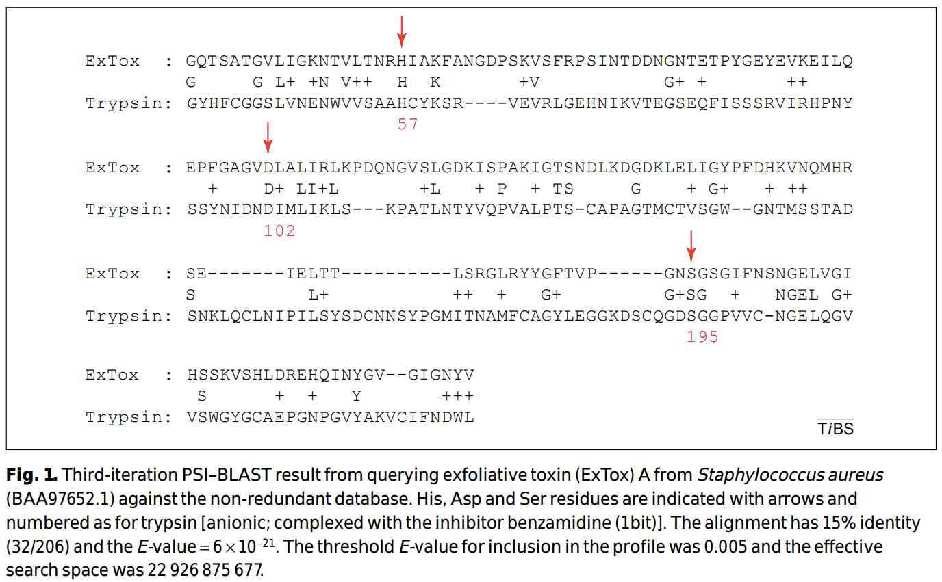
PSI-BLAST
10.1016/S0968-0004(01)02039-4

Slide 14
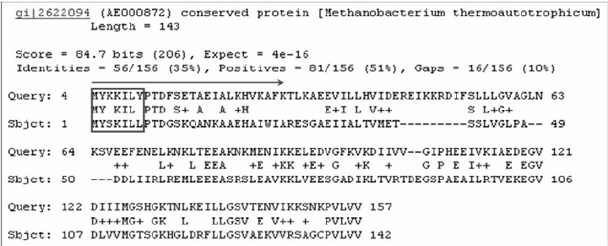
PSI-BLAST
An example of high-scoring segment pairs (HSP) found by PSI-BLAST. The first peptide pairs as marked by the box are similar, and we assign the secondary structure element of each amino acid in MYKKILY to its counterpart in MYSKILL.
10.1016/S0968-0004(01)02039-4

Slide 15
PSI-BLAST
Position Specific Iterated – BLAST A cycling/iterative method
Gives increased sensitivity for detecting distantly related proteins
Can give insight into functional relationships
Very refined statistical methods
●
●
●
●
●
Fast – still based on BLAST methods Simple to use
●
●

Slide 16
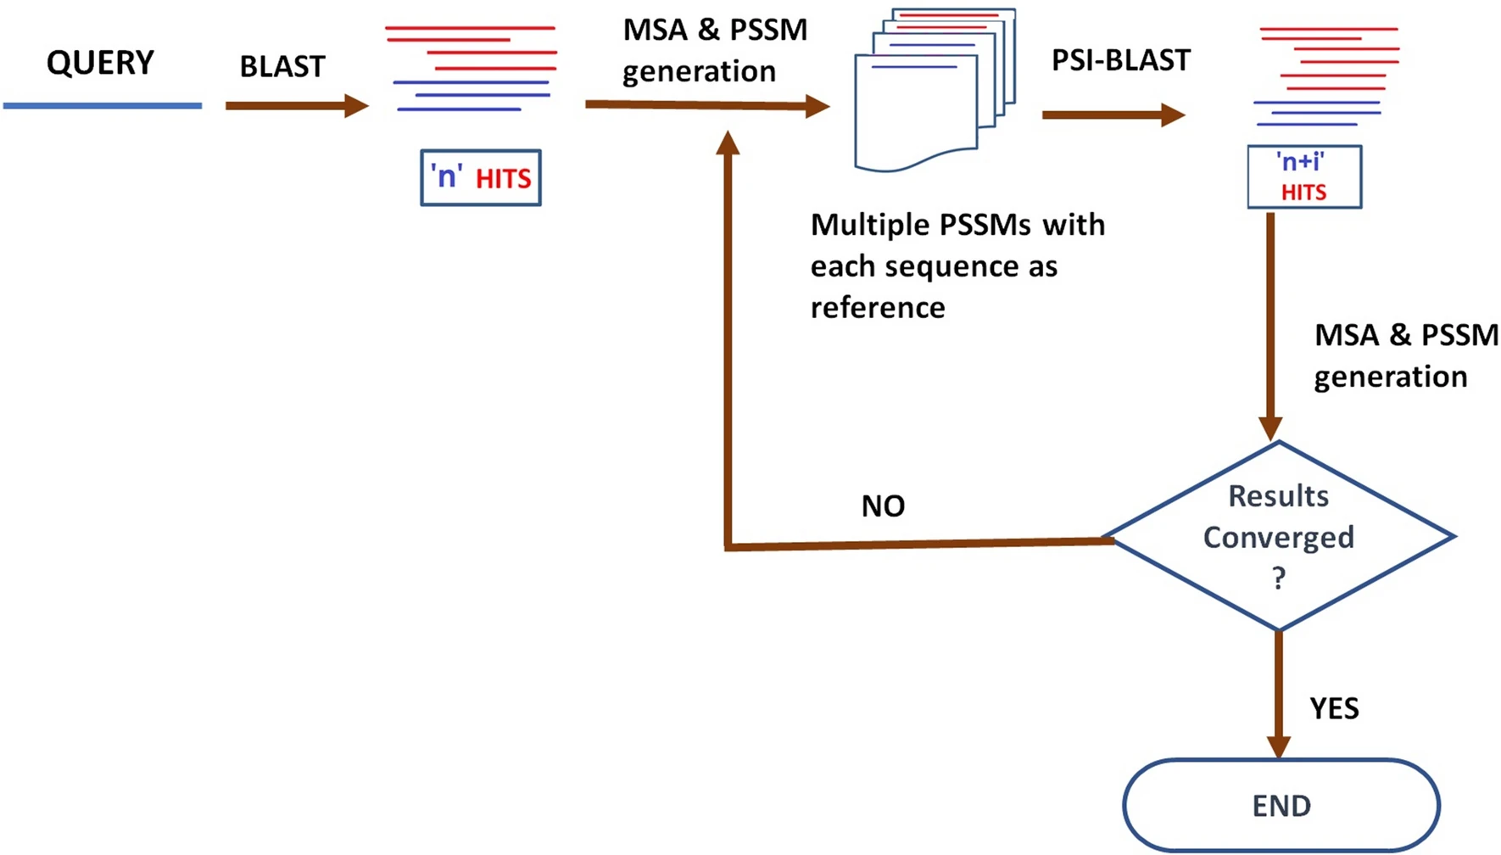
PSI-BLAST
Essentially we are using intermediate sequences to infer similarity between two sequences that are too dissimilar to link directly.
●

Slide 17
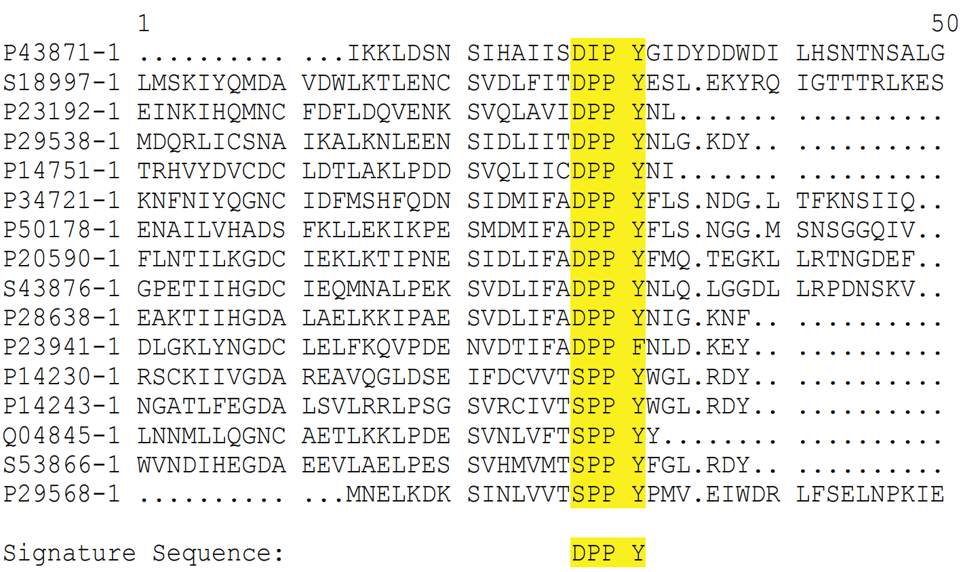
Profiles & PSSMs Need Multi-sequence Alignment

Slide 18
How does PSI-BLAST work?
First, a standard blastp is performed
2) The highest scoring hits are used to generate a multiple alignment
3) A Position Specific Scoring Matrix (PSSM) is generated from the multiple alignment.
Highly conserved residues get high scores
Less conserved residues get lower scores
The PSSM describes the sequence similarity between your query and all significant blastp hits
Another similarity search is performed, this time using the new PSSM as the query sequence.
This PSSM (scoring matrix) is now customized to find sequences that are related to your original query
Steps 2-4 can be repeated until convergence
Convergence occurs when no new sequences appear after iteration
8

Slide 19
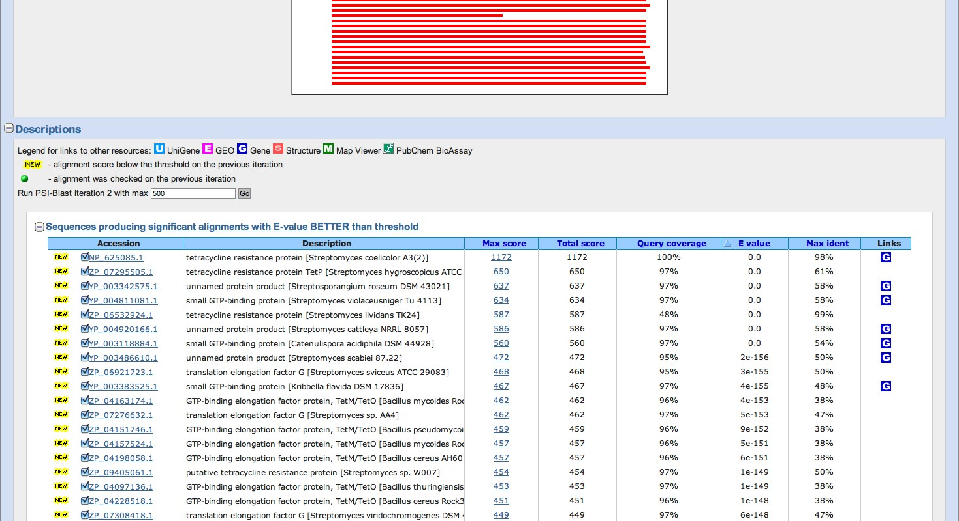
PSI-BLAST Example

Slide 20
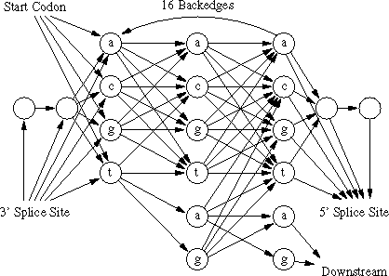
HMMs & HMMer
●
The more powerful way to search for protein families than PSSMs
Hidden Markov Models

Slide 21
Hidden Markov Models in Bioinformatics
●
Used extensively in gene prediction
●
Used to create Sequence Profiles and to classify sequences into families
●
Used in Multiple Sequence Alignment

Slide 22
HMMER 3
Suite of sequence analysis programs based on HMMs
●
●
Used to build the Pfam database
●
Available for free download at
●
http://hmmer.org/

Slide 23
HMMER 3
●
HMMER 2 was used for many years
●
Biggest draw back was always speed
●
HMMER 3 released in 2011
Very fast with comparable speeds to BLAST 100X faster than v2
●
●

Slide 24
HMMER Programs
●
hmmbuild – build a HMM from multiple sequence alignment
hmmscan – searches a query sequence(s) against a database of HMMs (used by PFAM)
hmmsearch– searches a query HMM against a database of sequences (e.g. like psi-blast)
phmmer – search a protein sequence vs a sequence database (e.g. like blastp)
●
●
●

Slide 25
HMMER Search & Software
●
http://hmmer.janelia.org/search
●
PFAM
●
http://pfam.sanger.ac.uk/

Slide 26
RNA Alignments
RNA alignments are “special”
RNA genes often have secondary structures that allow improved searching
Improved searching is needed since
●
●
●
●
Must search in DNA space (less complex then protein sequences)
Often shorter length then proteins
●

Slide 27
Infernal (RNA Search)
●
Infernal is like HMMER
Includes use of secondary structure information Uses profile “stochastic context-free grammar”
– SCFGs vs HMMs
“consensus RNA secondary structure proﬁles”
●
●
●
Infernal is slow!
Infernal can be used to search RFAM
●
●

Slide 28
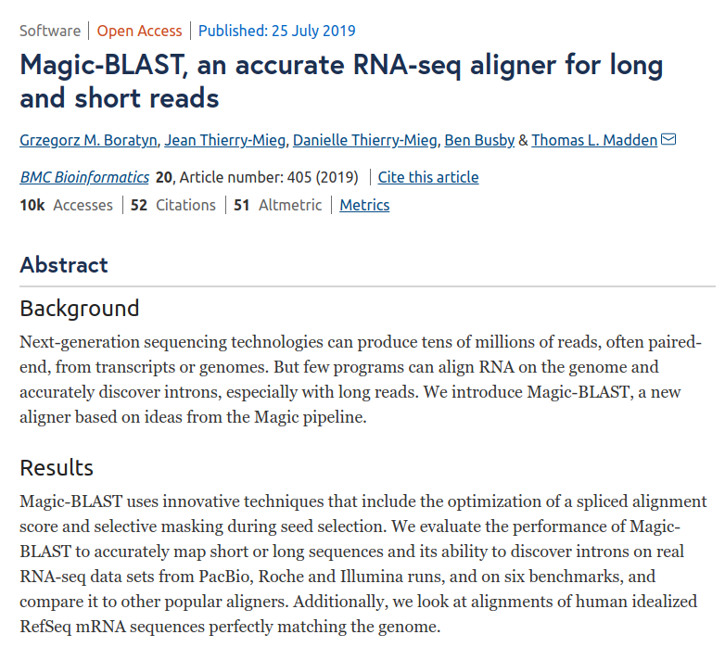
RNAseq alignment with Magic-BLAST
https://bmcbioinformatics.biomedcentral.com/articles/10.1186/s12859-019-2996-x

Slide 29
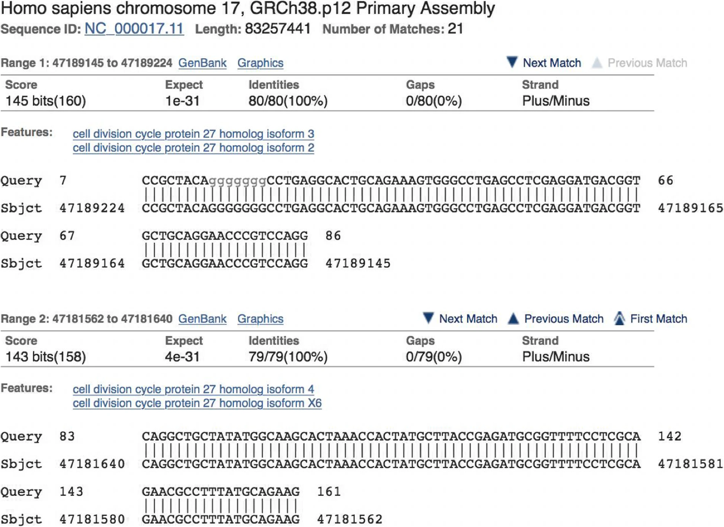
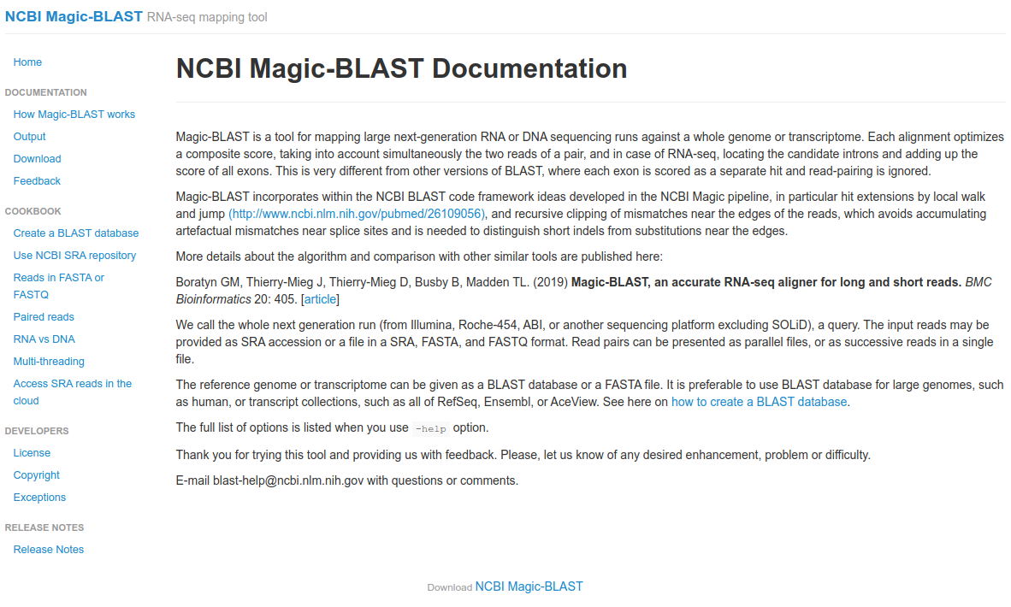
RNAseq alignment with Magic-BLAST
https://ncbi.github.io/magicblast/
https://bmcbioinformatics.biomedcentral.com/articles/10.1186/s12859-019-2996-x

Slide 30
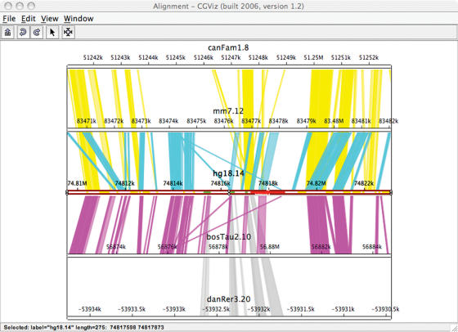
Genome Alignment

Slide 31
Genome Alignment
●
Genome alignment useful for
Visualizing genome
Rearrangements
Insertions/deletions
Inversions
Annotating genomes
Comparing gene annotations across species
●
●

Slide 32
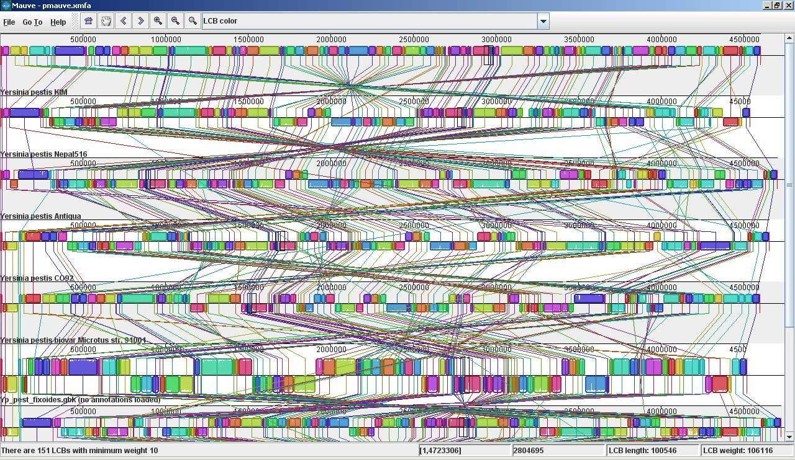
Mauve

Slide 33
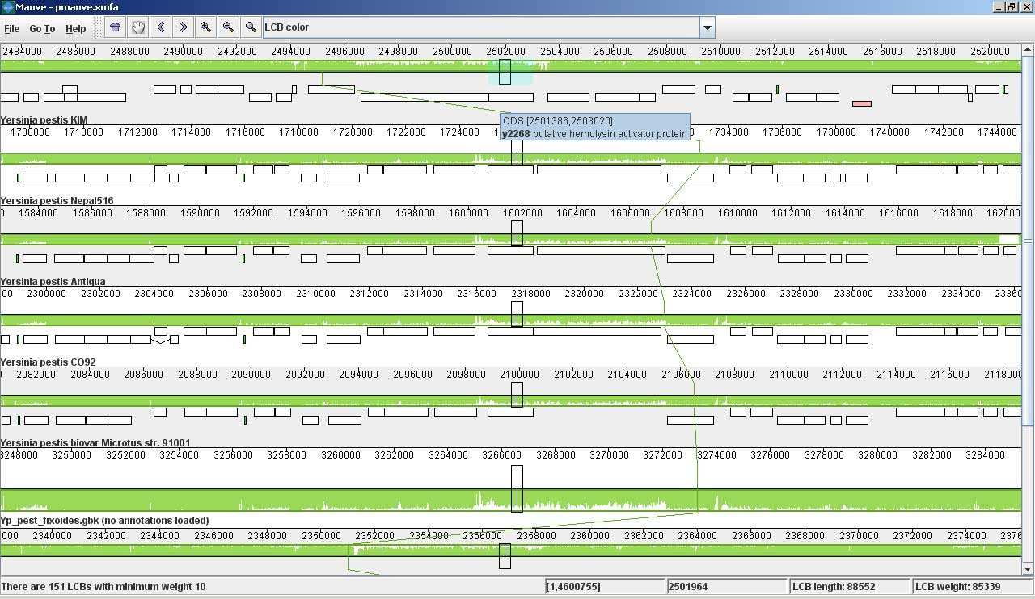
Mauve (zoomed in)

Slide 34
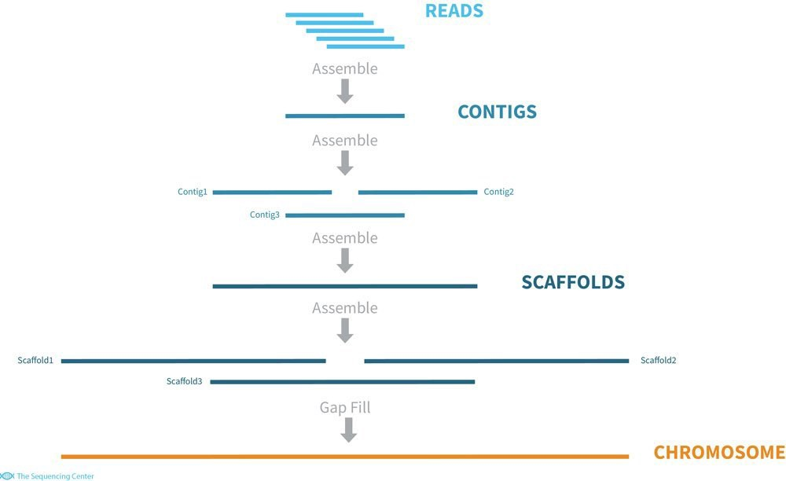
Assemblers

Slide 35
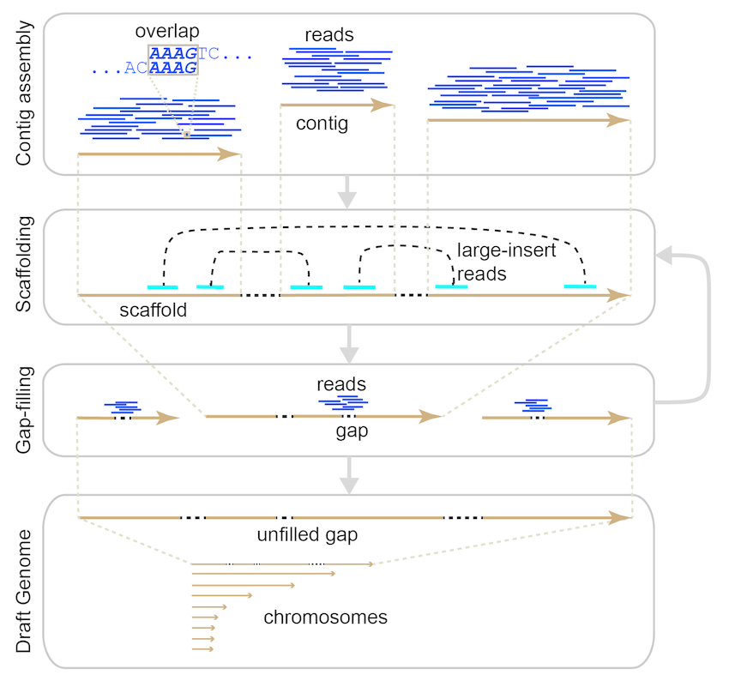
Assemblers
10.1093/BIB/BBW096

Slide 36
Assemblers
●
Assemblers job is to make longer sequences from shorter ones.
Nothing like homology searching
Must efficiently compare and join billions of sequences
Soap-Denovo: http://soap.genomics.org.cn/soapdenovo.html
Amos: http://sourceforge.net/apps/mediawiki/amos/index.php?title=AMOS
Many, many, more
●
●
●
●
●

Slide 37
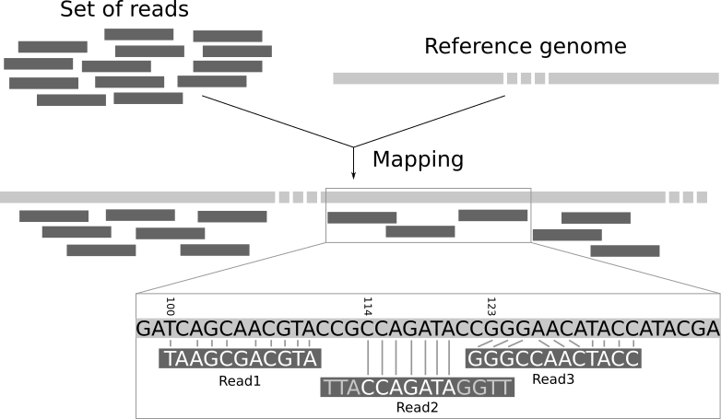
Mappers (Aligners)

Slide 38
Mappers
These map a read to a reference genome
Useful for assembly when a reference genome is already known
●
●
●
(think assembly of personal human genomes)
Identifying SNPs within the same species Very Fast!
BWA: https://github.com/lh3/bwa
Bowtie: http://bowtie-bio.sourceforge.net/index.shtml
Stampy: http://www.well.ox.ac.uk/project-stampy
Many Others
●
●
●
●
●
●

Slide 39
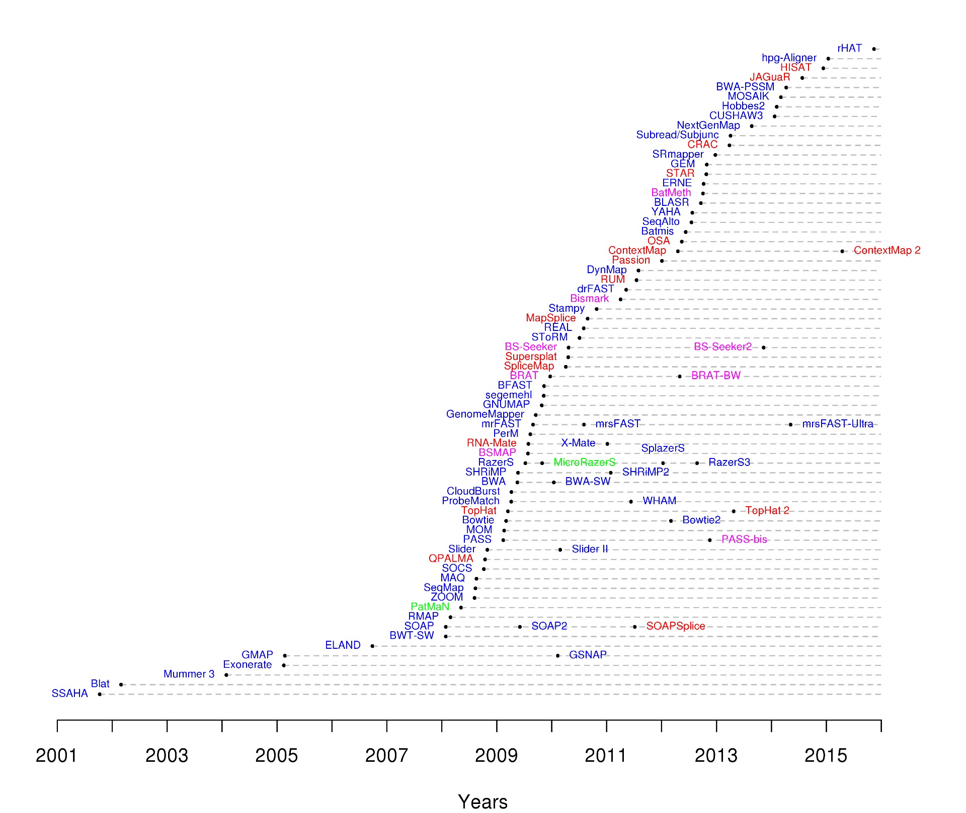
https://www.ecseq.com/support/benchmark

Slide 40
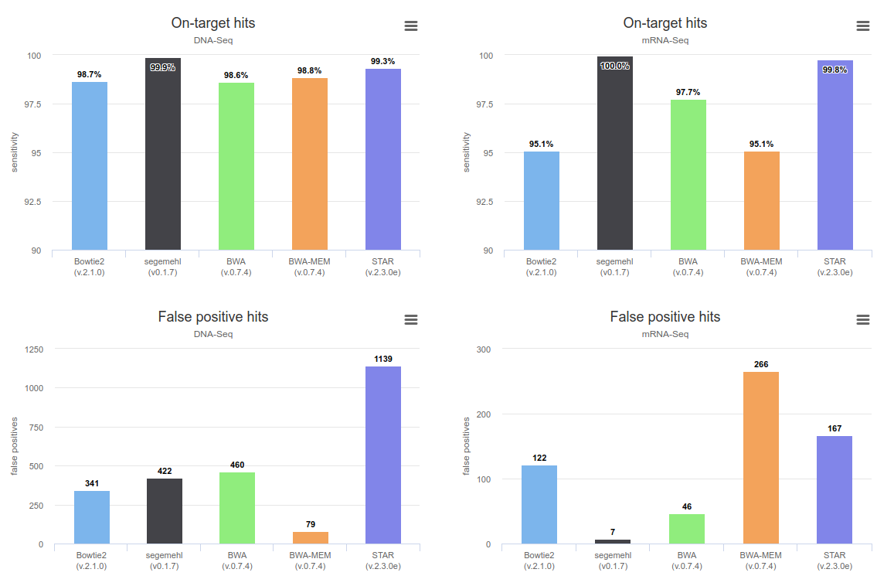
Otto C, Stadler PF, Hoffmann S: 'Lacking alignments? The next generation sequencing mapper segemehl revisited', Bioinformatics. 2014 Jul 1;30(13):1837-43 (2014)

Slide 41
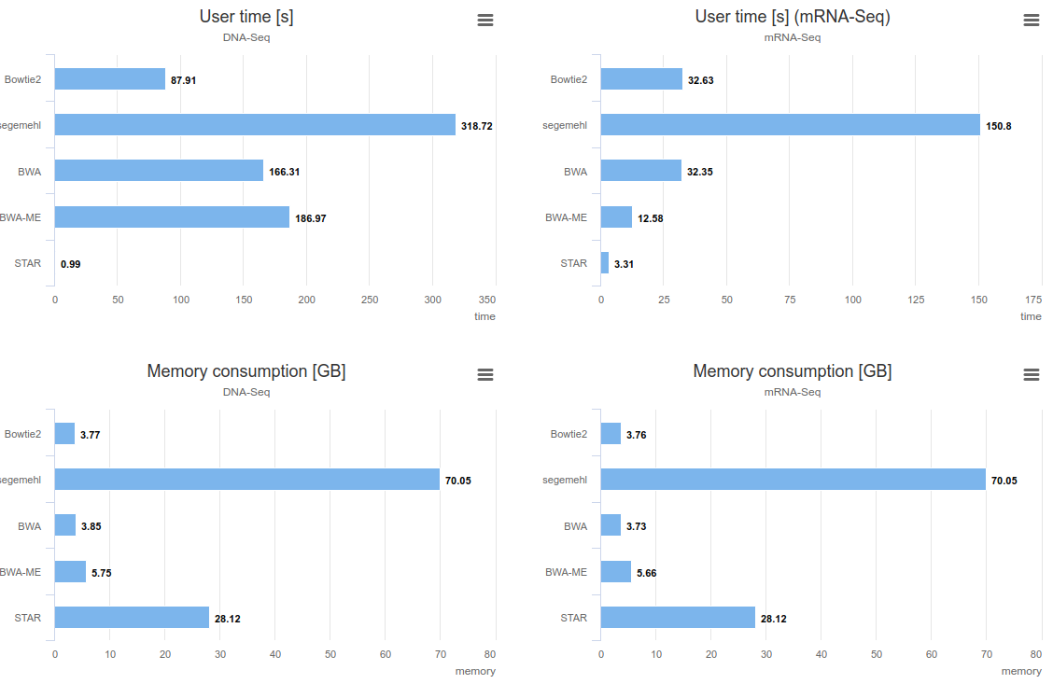
Otto C, Stadler PF, Hoffmann S: 'Lacking alignments? The next generation sequencing mapper segemehl revisited', Bioinformatics. 2014 Jul 1;30(13):1837-43 (2014)

Slide 42
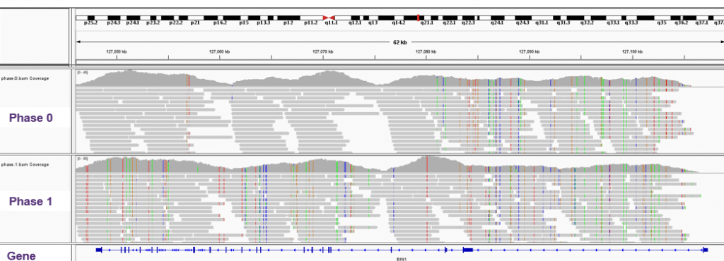
Mappers
IGV snapshot with reads in bam file

